Slide 1

Lesson Five Fission and Chain Reactions
The Harnessed Atom

Slide 2
What you need to know about Fission and Chain Reactions:
Fission
Chain reaction
Uranium fuel
Mining
Milling
Enrichment
Fuel fabrication

Slide 3

Nuclear energy starts with a split.
Energy is stored in the nuclei of atoms. Unstable atoms release energy all the time. But big energy happens when their nuclei split.
We call this split fission.
Notes:
Tell students: The start of a nuclear chain reaction in fuel happens inside a nuclear power plant and it is kept going in order to “harness” the energy. In this lesson, we’ll look closely at nuclear reactions called fission and fusion. We’ll also learn how uranium is processed from ore to fuel.
Remind students that nuclei is plural for nucleus.
95029399

Slide 4
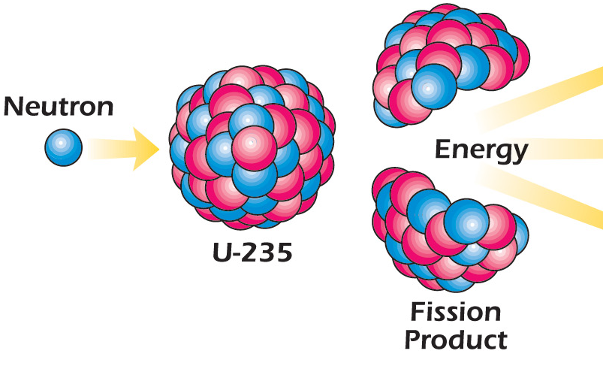




How does fission happen?
Step 1: A neutron strikes the nucleus of a heavy and unstable isotope, like U-235.
Step 2: The nucleus becomes unstable.
Step 3: The nucleus vibrates and splits.
This split is fission!
Notes:
Visual learners may need to be walked through the steps left to right. U-235 is uranium isotope 235.
Splitting uranium-235 takes about 1 microsecond (a millionth of a second)! For comparison, a single eye blink takes about 100 to 150 milliseconds (thousandths of a second). Ask students: which is faster, fission or the blink of your eye? (Fission is lots faster!)

Slide 5
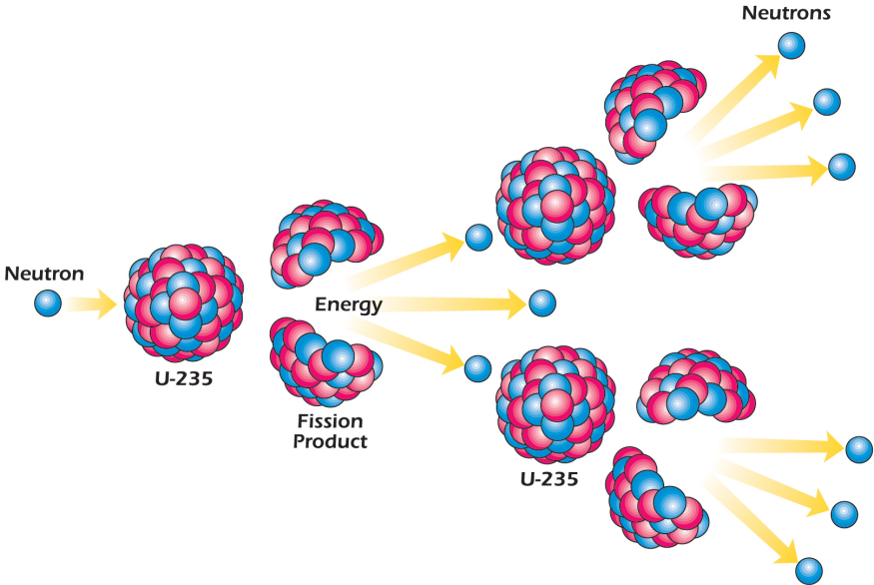
What happens next?
Fission produces
Two or three neutrons
Two lighter-weight atoms of new elements called fission products
Energy! (mainly as heat).
Notes:
Point out that as the atoms fission, the number of neutrons available to cause other atoms to split increases. One fission releases 2 to 3 neutrons, when some of these neutrons hit other U-235 atoms, each split atom releases 2 to 3 more neutrons.
The lighter-weight atoms of new elements are called fission products in this illustration.
Remind students that in Lesson 2 they learned about heat energy. Ask them: What does heat energy have to do with making electricity? Answer: Heat is used to heat water, produce steam, turn turbines that are connected to generators that create electricity.

Slide 6
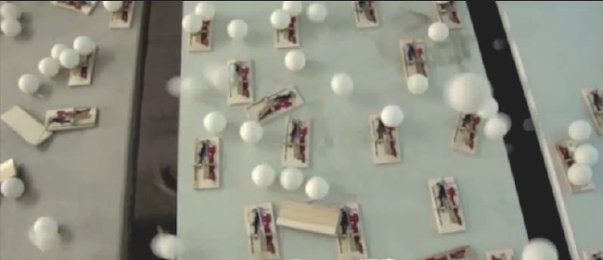
What happens next keeps happening.
In a nuclear chain reaction, fission releases more neutrons, which split more atoms, which split more atoms. We call it a chain reaction because it keeps happening!
Here is how two science classes demonstrated a chain reaction:
http://www.youtube.com/watch?v=0v8i4v1mieU&feature=player_embedded
http://www.youtube.com/watch?v=FQGtpo2IUxA&feature=fvwrel
Notes:
Both clips above run about 2.5 to 3 minutes each. Highlight the url with your cursor. Right click from your mouse to select “Open Hyperlink.”

Slide 7
What to remember
A neutron strikes a nucleus of a heavy, unstable isotope.
The nucleus splits (fission).
More neutrons strike more nuclei (chain reaction).
Heat energy produced.
Notes:
This is a mid-lesson review to make sure students have the terminology set before we go on.
Ask students: If you compare the terms on this slide to the ping pong ball video clip:
What was the equivalent to a neutron? (the ping pong balls)
What was the equivalent of the nucleus? (the mouse trap)
What was the chain reaction? (one ball hits a mouse trap that releases another ball that hits another trap and so on)
What was the energy released? (The product is not heat energy, like uranium-235 fission. The ping pong illustration produces mechanical energy, the energy of machines in motion. The mouse trap is a machine.)

Slide 8
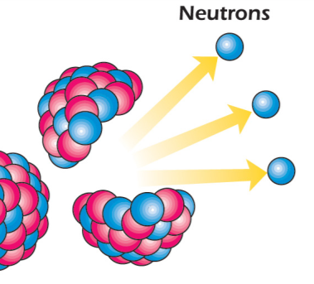

Keeping a nuclear chain reaction going is not easy.
Did all the ping pong balls “fission”?
Did all the matches light?
Is uranium-235 the same?
A nuclear chain reaction is more difficult to keep going because
Many of the neutrons will not hit another uranium atom.
As fewer fissions happen, the chain reaction slows down and stops.
probably
yes
no
Notes:
The difficulty of keeping a nuclear chain reaction going is potentially better understood by some students if the class participates in the Food Fight activity (described in Lesson 5 on page 14.)
Background: Enrico Fermi was the first scientist to achieve a nuclear fission chain reaction. He and a group of young scientists were experimenting at the University of Chicago on December 2, 1942.

Slide 9
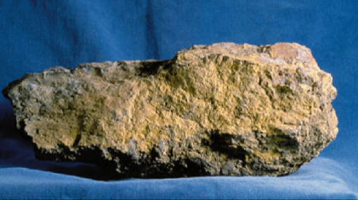
What is the fuel at a nuclear power plant?
A nuclear power plant uses uranium for fuel.
Uranium …..
Is a dense, heavy metal
Consists of atoms that hold a lot of energy in their nuclei
Is found in ordinary rocks and soil around the world.
Uranium ore is mined as rocks like this one.
Notes:
Typically, a ton of uranium ore contains 2 to 4 pounds of uranium. A standard dump truck holds about 25 tons.
Do most fuels have to be changed before they can be used? Yes.
Kerosene, gasoline, and heating oil are produced from crude oil by a series of processing steps called refining. Crude oil is refined to produce kerosene, gasoline, and heating oil by fractional distillation or “cracking.” Coal is cleaned and ground to the consistency of talcum powder before it is used in a coal-fired power plant. A distinctive odor is added to natural gas so people can detect its presence.

Slide 10
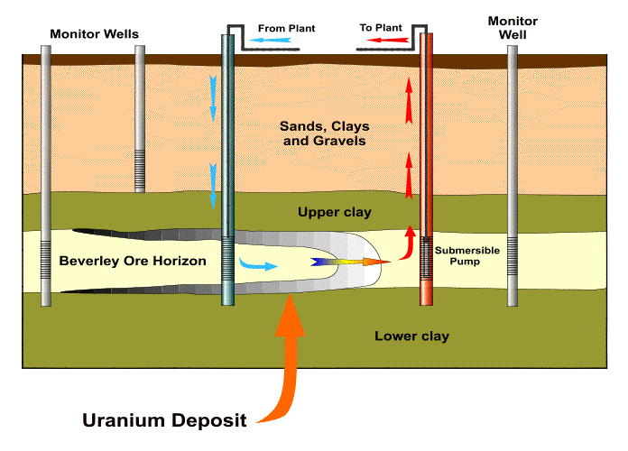
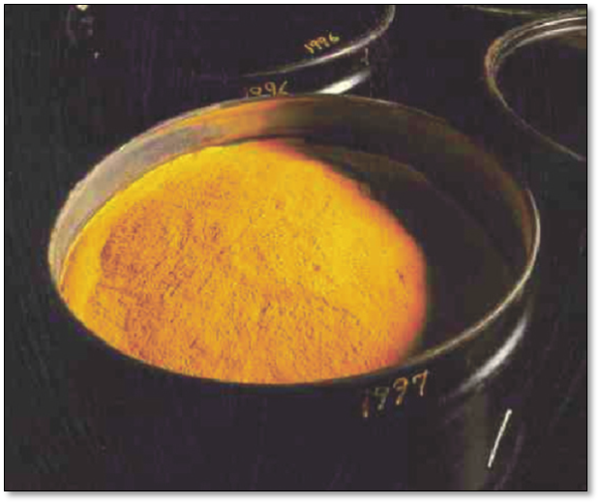
Uranium is mined like coal.
Most uranium is mined by a process is called in situ mining, which means mining “in place”
First, a well is drilled, and water and oxygen are injected into the ore deposit.
This causes the uranium in the ore to oxidize (rust) and wash out in the water.
The water is then pumped back to the surface and the uranium is filtered out.
What’s left is a dry, yellow powder called yellowcake.
Some uranium is also mined in surface and deep mines.
Source: World Nuclear Association
Notes:
Uranium is mined only where the concentrations are high enough to be worth the effort. Kazakhstan, Canada, and Australia are the top three producers and together account for 63% of world uranium production. There are uranium mines in the United States, but most are not active.

Slide 11


Making uranium “richer”
Only uranium-235 is fissionable.
Natural uranium in yellowcake is less than one percent U-235.
A nuclear power plant needs fuel that is four percent U-235.
Uranium need to be treated to be enriched to increase the percent of U-235.
= U-238
= U-235
natural uranium
(1% U-235)
enriched for power plants
(4% U-235)
Notes:
To help students understand the concept of enrichment, ask them to think about skim milk and whole milk.
Which milk is “richer” with fat? (Whole milk is about 3.25% milk fat. Skim is 1% milk fat.) Source: USDA, http://www.ams.usda.gov/AMSv1.0/getfile?dDocName=STELDEV3006749
You may have a student ask about nuclear weapons enrichment. Weapons-grade uranium is enriched to 90% U-235. (Again using the analogy above, butter is 80% fat.)

Slide 12
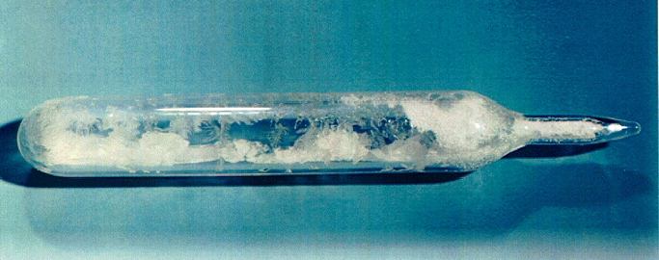
UF₆ is a solid, gas, and liquid.
Before it can be enriched, yellowcake is converted into uranium hexafluoride (UF₆).
At room temperature, UF₆ changes into solid crystals that look like this:
When the crystals are heated, they become a gas.
Notes:
UF₆ crystals are sealed in an ampoule in this photo. UF₆ is corrosive to most metals and reacts violently to water. So it needs to be sealed and treated safely.
Tell students that the “hex” in hexafluoride is from the Greek word that means six. We use it in the word hexagon, a shape that has six sides. Lots of pencils have hexagon shapes.
DOE photo: Uranium_hexafluoride_crystals_sealed_in_an_ampoule.jpg PD-USGOV-DOE; from http://web.ead.anl.gov/uranium/about/index.cfm

Slide 13
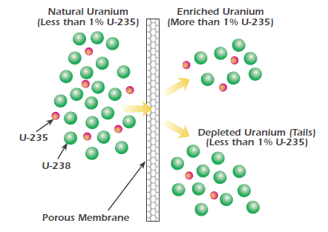
Gaseous diffusion
Uranium hexafluoride (UF₆) is enriched by either gaseous diffusion or gas centrifuge.
Gaseous diffusion pumps UF₆ gas through filters. The slightly heavier U-238 doesn’t pass through the membrane as easily as U-235.
Notes:
The drawing shows one step in the process. As UF₆ gas passes through each successive barrier in a diffusion plant (shown here as the porous membrane), the gas has a slightly higher concentration of U-235. At the end of the entire process, the percent of U-235 has increased to 3 percent.
Tell Students: the porous membrane is like a screen on a window. It will keep out insects larger than the holes but smaller ones can slip in.

Slide 14
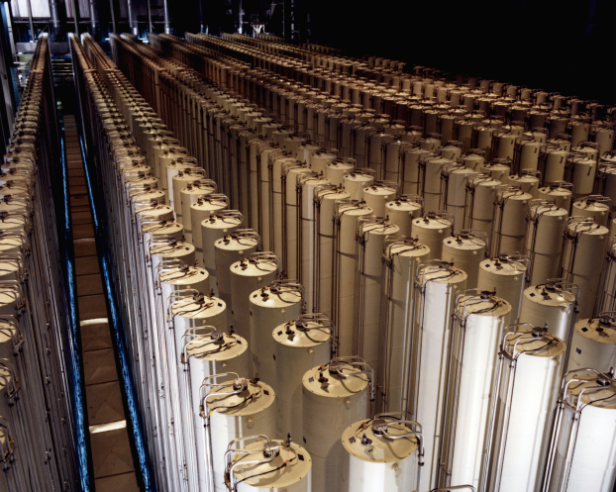
Gas centrifuge
The gas centrifuge process is another way to enrich uranium.
This process uses a spinning cylinder, much the way a washer spins water out of wet clothes.
The spinning throws the heavier U-238 atoms toward the outside while the lighter U-235 atoms collect near the center.
Notes:
The photograph shows cascades of gas centrifuges used to produce enriched uranium at the U.S. gas centrifuge plant in Piketon, Ohio. Each cylinder is about 12 meters tall. That’s taller than a three-story building.
DOE photo: Gas centrifuge cascade.jpg PD-USGOV-DOE; from Source: http://www.doedigitalarchive.doe.gov/ImageDetailView.cfm?ImageID=1000682&page=search&pageid=thumb

Slide 15

You already know how centrifuge works.
Think about being in a car going around a sharp curve. Your body is pulled toward the door of the car. Meanwhile the potato chip on your seat may not move much.
The same force makes a centrifuge work. The heavier U-238 molecules move toward the outside wall while the lighter U-235 molecules collect near the center.
Notes:
Ask students if to think about inertia on their school buses. If people are standing, watch how they lean as the bus goes around a curve. Where is the center of rotation?
Ask students if they can think of other examples of when thisl force is used. One answer: a washing machine uses it to separate the water from the clothes. The clothes are spun to the walls of the tub.
This is a good time to use the salad spinner exercise in the workbook.
Do the class experiment in this chapter on centrifuges. Students will learn that what we call “centrifugal force” does not really exist. It is actually the combination of centripetal force and inertia.

Slide 16
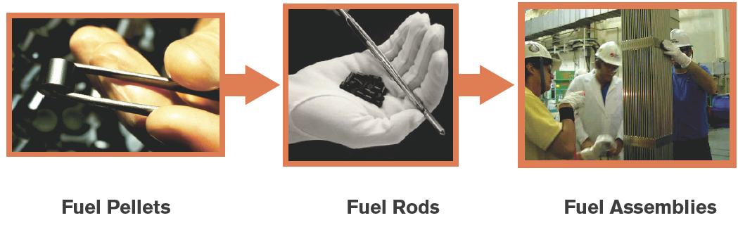
Ready for a nuclear power plant
Enriched uranium for a power plant has about 4 percent U-235. It is
Made into a ceramic material
Formed into small fuel pellets
Stacked in rods that are grouped into assemblies
Sent to nuclear power plants. The fuel lasts for 3 years.
Notes:
The first photo shows an individual fuel pellet. A uranium fuel pellet weighs less than half an ounce, which is less than an empty aluminum soft drink can. It has the energy of a ton of coal.
Before use in the nuclear reactor, the fuel assemblies are not very radioactive.
Ceramics can withstand the very high temperatures of a reactor without melting.

Slide 17
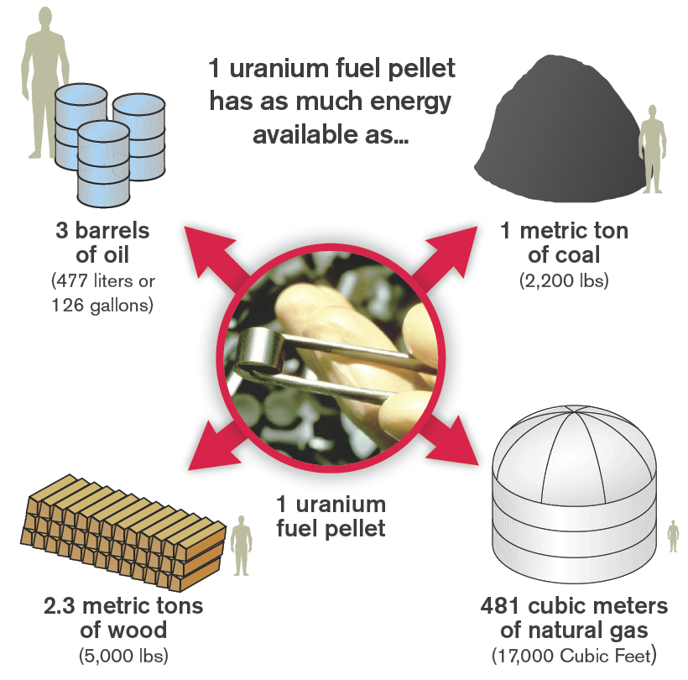
Energy Equivalents
Fuels have different energy content. Some sources produce the same amount of electricity from less fuel.
Notes:
One uranium fuel pellet, about the size of the tip of your little finger, has the equivalent energy potential of 481 cubic meters of natural gas, 2,200 pounds of coal, or 477 liters of oil or 2.3 metric tons of wood. Ask students: “What does this comparison mean?” (Less uranium is required to produce electricity than other fuel sources.). Any one of these sources powers an average American home for about 75 days.
From: http://www.fchea.org/core/import/PDFs/factsheets/factSheet_productionNuclear.pdf
By the time the pellets are stacked in rods, bound together in fuel assemblies, and then placed in the reactor, there is a very large amount of potential energy available to generate heat and make electricity.
Source: http://www.nei.org/howitworks/nuclearpowerplantfuel/
http://lobby.la.psu.edu/066_Nuclear_Repository/Agency_Activities/YMP/YMP_General_Information_What_is_nuclear_fuel_and_waste.htm

Slide 18
Summary: Fill in the blanks
Fission occurs when a neutron strikes the nucleus of a uranium-235 atom, causing the atom to split apart.
Two new lighter weight atoms, two or three neutrons, and a lot of energy (mostly as heat) are released.
If the neutrons that were released hit other uranium-235 atoms, these atoms may fission.
Within seconds, millions of atoms can be fissioning. This sequence of events is called a nuclear chain reaction.
Notes:
The answers are in the sentences above. You can turn this page into an activity using your cursor to highlight the blank spaces. Use your toolbar to make the answers’ font not white.
Review these facts with students before or after a quiz.

Slide 19
Summary (continued)
The fuel for nuclear power plants is uranium.
Uranium is a dense metal found in rocks and soil around the world.
Rock that contains 2 to 4 pounds of uranium per ton is uranium ore.
Uranium must be mined and milled.
Milled uranium is converted to a gas.
To be useful in a power plant, uranium must be enriched so the percent of U-235 is increased.
Notes:
The answers are in the sentences above. You can turn this page into an activity using your cursor to highlight the blank spaces. Use your toolbar to make the answers’ font not white.
Review these facts with students before or after a quiz.

Slide 20
Summary (continued)
Less than 1 percent of the atoms in uranium ore are uranium-235.
But power plants need uranium that is about 4 percent uranium-235.
Uranium enrichment process raises the concentration of uranium-235 based on the fact that uranium-238 atoms have a tiny bit more mass than uranium-235 atoms.
In addition to fission, or splitting atoms of heavy elements, scientists are learning how to control another type of nuclear reaction called fusion. Fusion occurs when light atoms of hydrogen join together (or fuse) to create helium and release a large amount of energy.
Notes:
The answers are in the sentences above. You can turn this page into an activity using your cursor to highlight the blank spaces. Use your toolbar to make the answers’ font not white.
Review these facts with students before or after a quiz. Students may also answer in the third question above that fuel pellets are stacked in fuel rods.

Slide 21
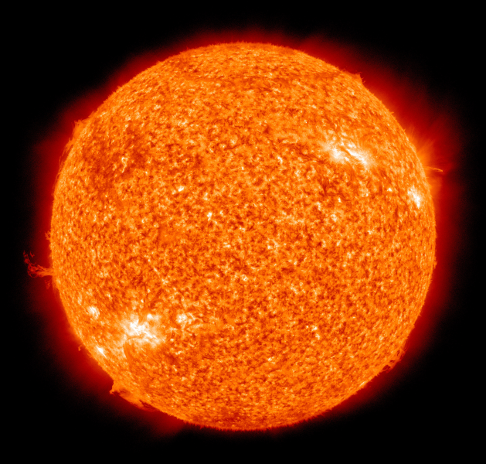
Advanced Student Assignment: Fusion
Fusion is the opposite of fission. Fusion is a nuclear reaction in which light isotopes of hydrogen fuse together.
Fusion
Creates new atoms
Releases a large amount of energy
May someday offer clean, abundant
energy
Your assignment is to research how fusion happens on the Sun.
How is fusion different on the Earth?
Notes:
Main idea: Fission splits atoms apart. Fusion joins atoms together. Both produce energy. Students can find the answers to this assignment’s questions in their student readers.
The Sun’s energy is produced through fusion. Why is fusion different on Earth?
Gravity: The Sun’s gravity holds atoms together. On Earth, our gravity is different. Scientist studying fusion use magnetic fields to allow hydrogen isotopes to fuse. So far, scientists have been able to maintain a controlled, continuous fusion reaction for only fractions of a second.
Heat: Atoms can be forced together more easily at high temperatures. The Sun obviously has a heat advantage over Earth. Hydrogen becomes plasma at high temperatures. One way to hold plasma to 100 million degrees Celsius (212 Fahrenheit) is to use magnetic fields to keep plasma away from the container walls. Another way uses lasers or intense x-rays to hold the fuel. So far, these two methods have worked for fractions of a second.
This is a false color image of the sun observed in the extreme ultraviolet region of the spectrum. The Sun by the Atmospheric Imaging Assembly of NASA's Solar Dynamics Observatory - 20100819.jpg ; from the Solar Dynamics Observatory's website

Slide 22
Lesson 5 Vocabulary
centrifuge – a machine used to enrich uranium or separate uranium-235 from uranium-238 so the uranium-235 can be made into fuel for nuclear power plants
ceramic – a very hard, non-metal material that can withstand very high temperatures without melting and does not easily corrode; used for fuel pellets for nuclear power plants
fission – to divide or split apart; the process of splitting apart; at a nuclear power plant it refers to splitting atoms
fission products – the atomic fragments left after a large atomic nucleus fissions or splits
fuel assembly – structure containing fuel rods that hold stacked uranium pellets; bundles of fuel rods that are loaded in the reactor core

Slide 23
Vocabulary
fuel pellet – a cylinder about the size of your fingertip that is the fuel for nuclear power plants
fuel rod – long metal tube that holds nuclear fuel pellets
fusion - a nuclear reaction in which light isotopes of hydrogen fuse together
inertia– the property of matter to resist change in its motion. An object in motion remains in motion unless another force acts on it. An object that is not in motion remains at rest unless a force acts on it.
in situ – situated in the original, natural place
leaching – the movement of a substance that has dissolved in a liquid
milling – a process of grinding and crushing ore

Slide 24
Vocabulary
mill tailings – the radioactive, sand-like materials that remain after uranium is extracted from uranium ore; contain hazardous substances and radium, which decays to produce radon; require special disposal
nuclear chain reaction – a process in which neutrons released in fission produce an additional fission in at least one further nucleus
ore – a metal-bearing mineral that can be profitably mined
reactor – the part of a nuclear power plant where fission takes place
reclamation – restoration to a useful condition
uranium enrichment – the process of increasing the percent of uranium-235 for nuclear power plant fuel

Slide 25
Vocabulary
uranium hexafluoride (UF₆) – a compound made from uranium and fluorine; changes to a gas when heated; used in uranium enrichment process
yellowcake – a yellow powder that is mostly uranium

